Slide 1
Rajan works

Slide 2
Roles and structure of group
Team members
Vidhi Modi (30391470) – Project Manager and Scrum Master, Developer
Rajan Patel (30391474) – Process Analyst and Change Manager and web tester
Sajal Singh (30376237) – Developer and UX/UI Designers.
Hetkumar Patel (30391427) – Operational Manager and Analyst and Web tester.

Slide 3

Clients
1.Marketa Mojzisova, E/L Programme Manager
2.Anirudh Phadke, Head of Digital Content
3.Supriyo Chaudhuri, Chief Learning Officer

Slide 4
Theme and Wishlist
For sprint 3 the theme of our project is to create the career intelligence website profile page.
The Wishlist for sprint 3 of our project is to designing the profile page with having the social media connections and creating the website profile page error free.

Slide 5

Technical aspects of the project
GitHub – Project Management
Trello – Project Management
MS-teams- Team meeting and client meeting
Figma – UX designing Coding
Html
CSS
JAVASCRIPT
XAMPP- MySQL, phpMyAdmin
PHP
https://validator.w3.org/
Software testing

Slide 6
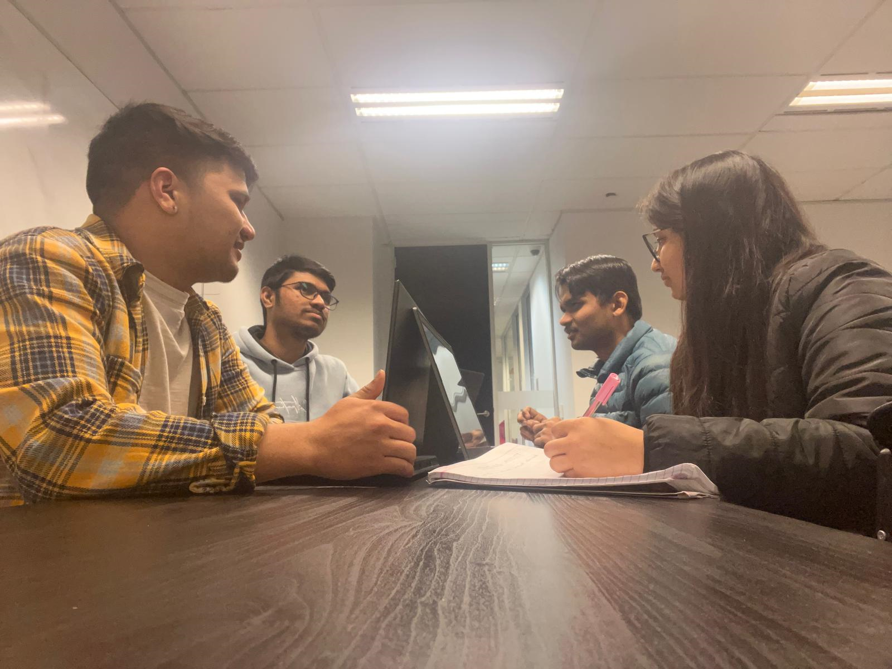
Meeting before the client meeting.

Slide 7
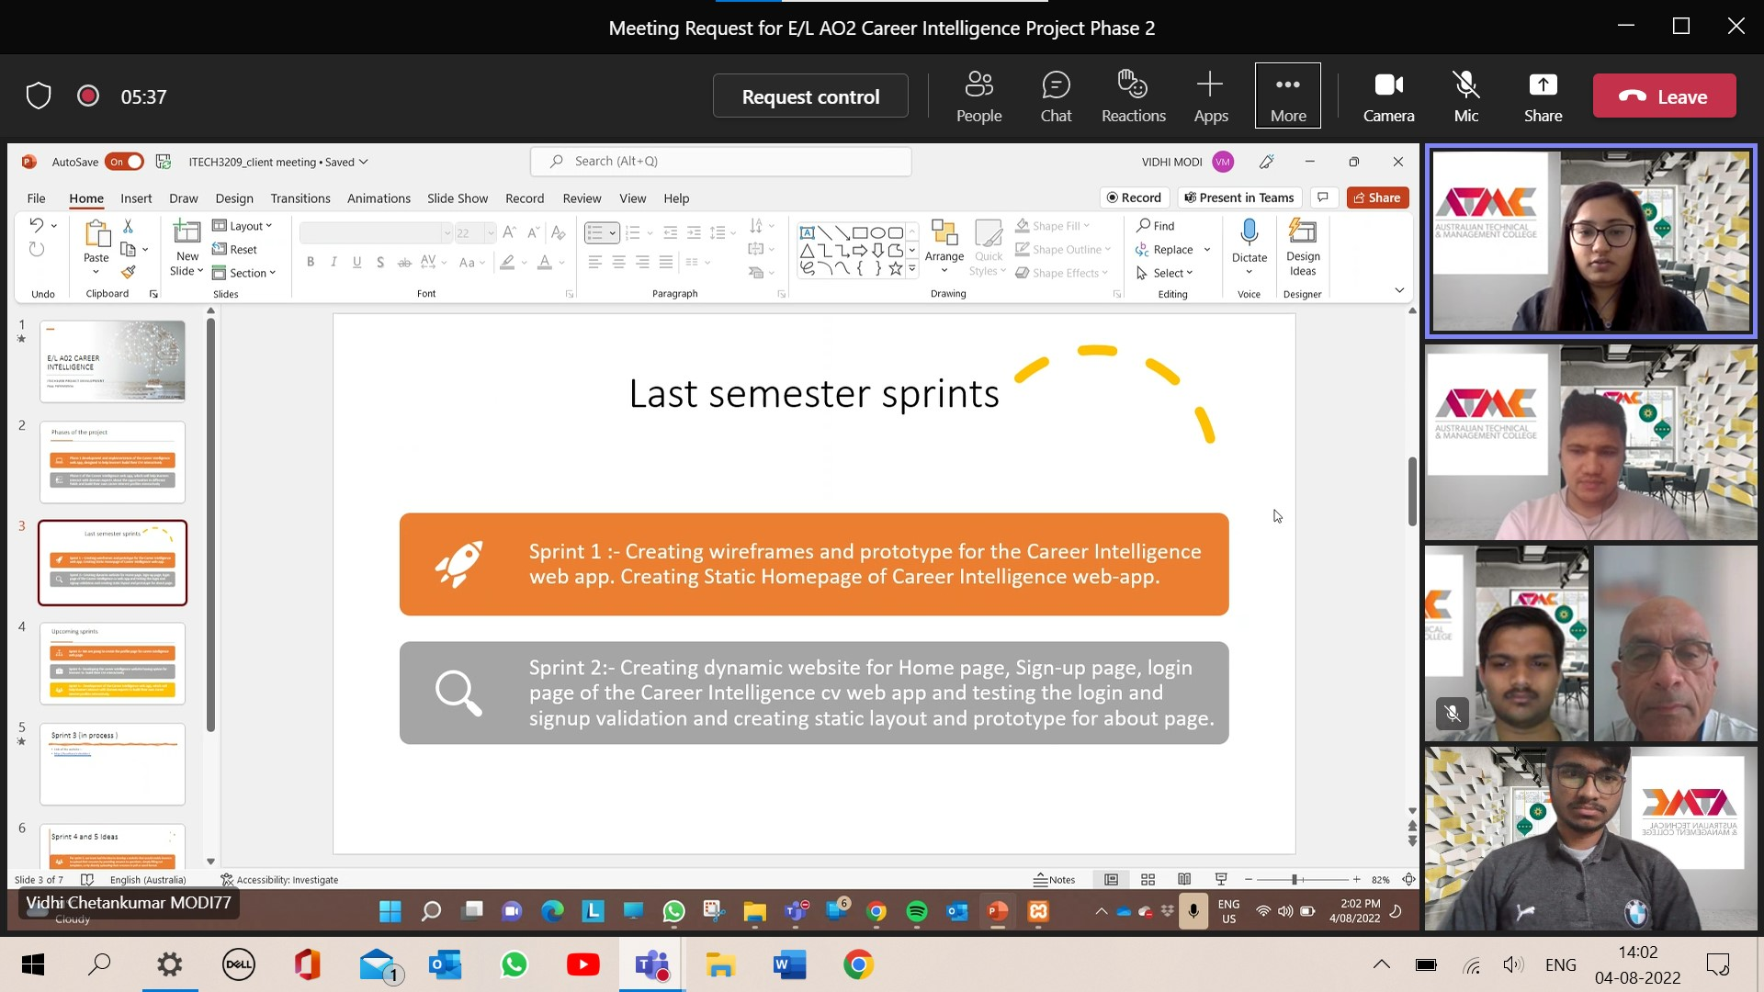
Proof of the meeting with clients

Slide 8
Minutes of meeting with clients.
The client told us to improve the password functionalities.
The client also informed as some of the errors they find from the website like spelling errors , phone number validation errors.
The client also informed us that next time they want our social connects to be work.
Moreover , they also suggest us that building CV with AI algorithms would be going to be complex so instead of building it we should work on having LinkedIn connections would be good if we can.
The client also suggest us to focus more on booking session for the users with experts first.​
Moreover, the client suggest us to bring the option of uploading CV in the website.​
Finally at the end of the meeting they informed us that next time they want our database structure ready for CV .​

Slide 9
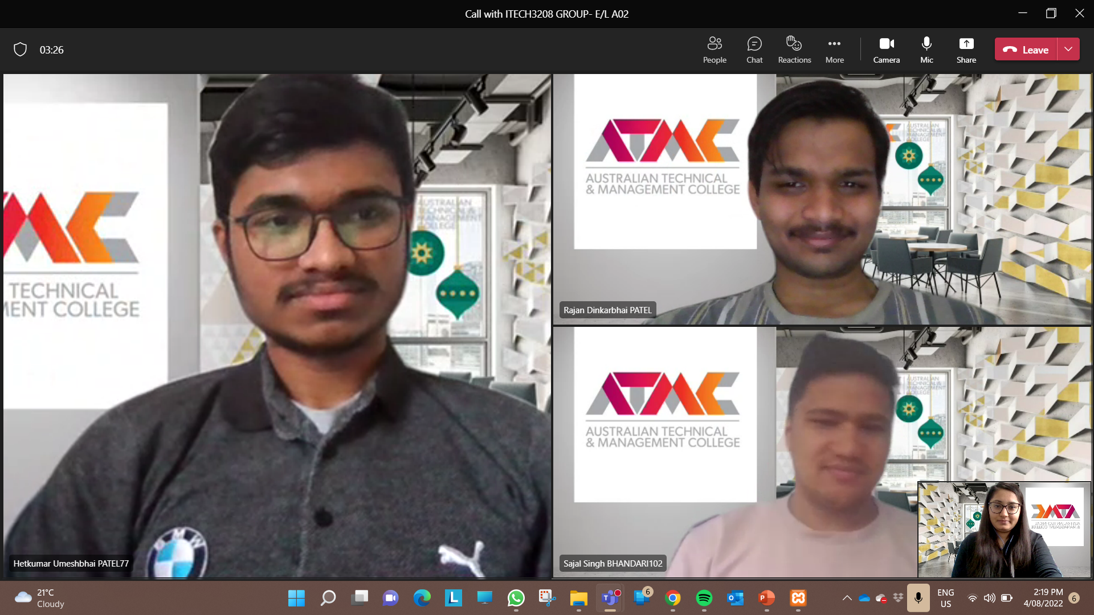
Proof of meeting with peers

Slide 10
Critical Reflection
1.What went well?
The client appreciated our efforts and offered suggestions for the next sprint.
Everyone who attended the meeting arrived on time.
The website's profile page was expertly created so that anyone could grasp the layout and complete the form.
The coding for the website works without any error.
2. What went wrong?
While discussing the third sprint with the client, they pointed out certain functional issues with our website that we need to fix before the next meeting.
Second, our plan to have CV templates and then construct CVs has been changed to just uploading CV and making booking sessions.
3. What was not in our control?
Due to the client's unavailability for meetings, it was unable to arrange client meetings every week to discuss the sprint.

Slide 11
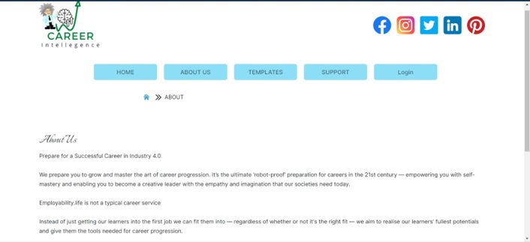
Front End developer

Slide 12
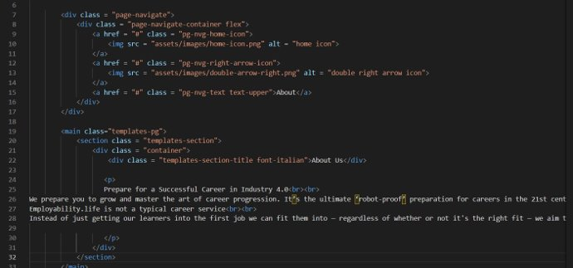
Coding for About Us page

Slide 13
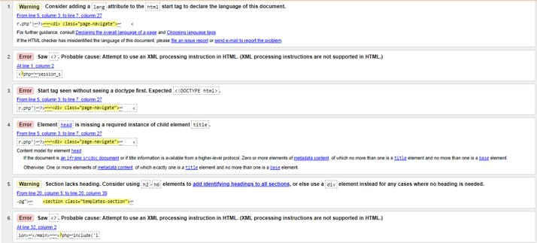
Testing for support page

Slide 14
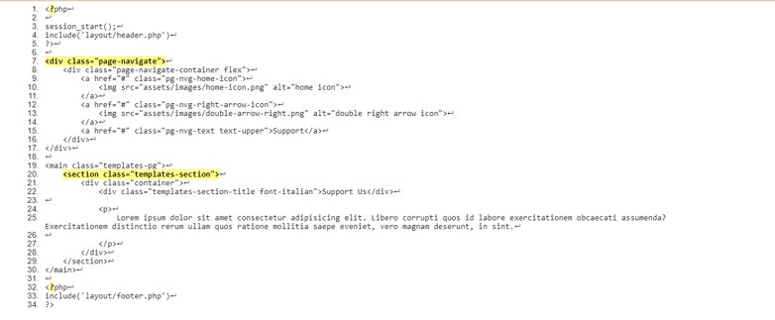
Result of the testing the code

Slide 15
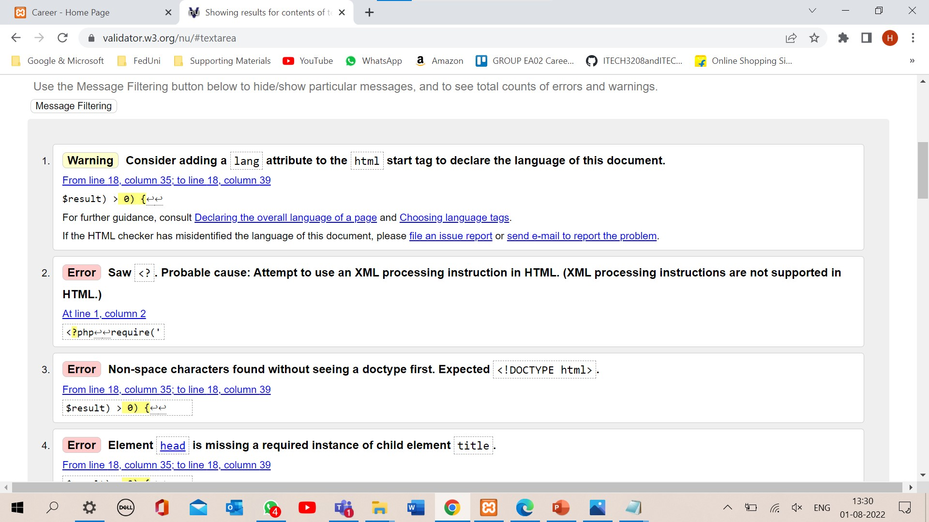
Testing for login page

Slide 16
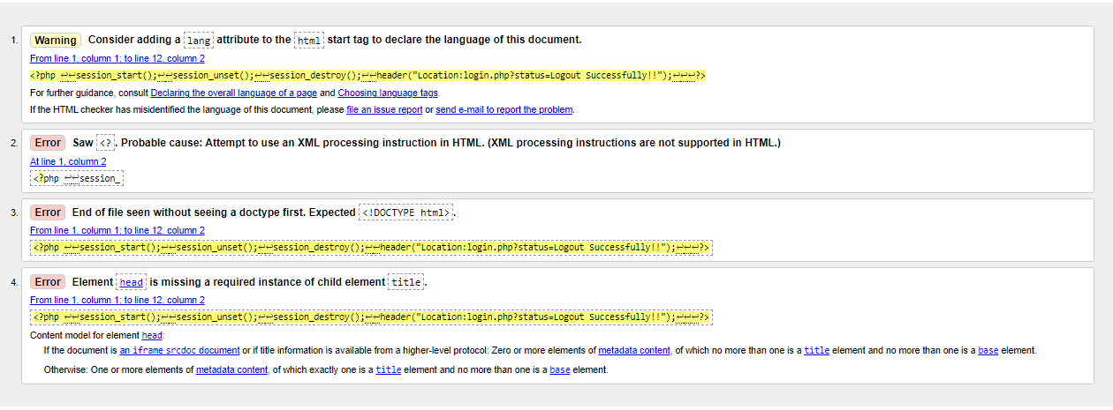
Testing for Logout page

